Slide 1


Investigating the Influence of Modifiable and Non-Modifiable Risk Factors on Cardiovascular Disease Prevalence in Adults
HDS 5310
GROUP MEMBERS 1. Dedeepya Ravipati 2. Murali Krishna Enugula 3. Swetha 4. Revathi 5. Tejaswi
PROFESSOR
Jason Dorothy

Slide 2
Research Question ?

Slide 3
"What are the independent and interactive effects of modifiable risk factors (body mass index, cholesterol levels, alcohol consumption, smoking status) and non-modifiable risk factors (age, blood pressure category, family history of cardiovascular disease) on the prevalence of cardiovascular diseases in the adult population?"

Slide 4
Introduction

Slide 5
Cardiovascular Disease: A type of disease that affects the heart or blood vessels. The risk of certain cardiovascular diseases may be increased by smoking, high blood pressure, high cholesterol unhealthy diet & lack of exercise and obesity.

Slide 6
Why is your research question important? Since cardiovascular diseases (CVDs) are one of the major causes of death globally, it is essential to comprehend risk variables in order to create preventative and therapeutic plans that work. Examining modifiable characteristics such as body mass index, cholesterol, alcohol intake, and smoking status can help shape public health policies and lifestyle programs targeted at lowering the burden of cardiovascular disease. Analyzing characteristics that cannot be changed, such age, blood pressure category, and family history, can assist in identifying high-risk groups in need of close observation and preventive actions.

Slide 7
Are there any existing studies done before for the same research question? Infact, studies have been done in the past on the risk factors for CVD, but their main objective is to determine how common certain risk factors are or how often they co-occur.

Slide 8
If it has been done, how will your project be different from others? By addressing the gaps, our research project has the potential to contribute to a more comprehensive understanding of the complex interplay between modifiable and non-modifiable risk factors, their independent and interactive effects, and their associations with both clinical and subclinical manifestations of CVDs in the adult population. These studies primarily focus on estimating the prevalence of individual risk factors and their co-occurrence, leaving a gap in our understanding of their independent and interactive effects on the actual prevalence or incidence of CVDs. This gap could be addressed by quantitatively assessing how specific modifiable risk factors, such as body mass index, cholesterol levels, alcohol consumption, and smoking status, independently and interactively influence the likelihood of developing CVDs in the adult population. .

Slide 9
Which health data source is used? Detailed information on demographics, clinical measures, lifestyle factors, and CVD outcomes are all included in the large dataset that we used from Kaggle.

Slide 10
Dependent variable The analysis's goal is to find out how common clinically significant cardiovascular disease events are among adults and how these events relate to risk variables.

Slide 11
Independent variables Modifiable factors: body mass index, cholesterol levels, alcohol consumption, smoking status, physical activity Non-modifiable factors: age, gender, blood pressure category, family history of CVD. Why did you decide to choose these independent variables from the dataset? The variables were selected based on their well-established cardiovascular implications and the most recent evidence from previous studies. Are they different from past studies? The study sets itself apart from earlier studies by taking into account potential interactions between modifiable hazards and non-modifiable characteristics such as blood pressure category and family history of CVD.

Slide 12
What is the significance of your research question? The significance of the study is to improve our understanding of the complex interactions between modifiable and non-modifiable risk variables, their consequences, and their relationships with adult cardiovascular disease (CVD) outcomes.

Slide 13
Are there any practical implications? 1. Based on individual risk factors, the study's findings can help physicians manage the risk of cardiovascular disease (CVD) and develop individualized treatment plans. 2. The results can direct policy and public health programs, emphasizing the promotion of healthy lifestyles and the management of particular risk factors. 3. In order to identify high-risk individuals and maximize resource allocation for prevention, the research can improve the accuracy of predictive models and risk assessment tools. 4. According to the study, patient education materials can assist people in understanding and lowering their risk of CVD, which can result in healthier lifestyle decisions. 5. Finding new therapy targets and improving the efficacy of currently available drugs to treat cardiovascular illness are two ways that the research may further pharmaceutical development.

Slide 14
Methodology

Slide 15
Descriptive Statistics The descriptive statistics of CVDdata_cleaned offer insights into the dataset's cardiovascular-related variables. They include measures like mean, median, standard deviation for continuous variables (e.g., age, BMI) and frequency tables for categorical variables (e.g., gender, smoking status). Graphs like histograms and bar plots visualize data distribution. These stats help understand participant characteristics, spot outliers, and guide further analysis on cardiovascular disease.

Slide 16
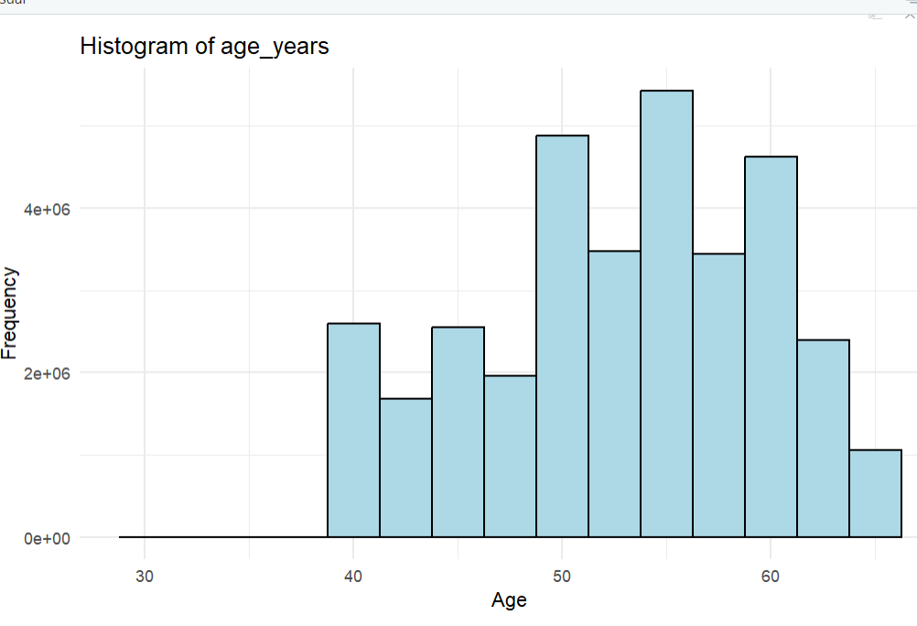
HISTOGRAM FOR AGE FREQUENCIES
The distribution exhibits a right-skewed pattern, with the tallest bar indicating the age group with the highest frequency is around 50 years old. The frequency decreases for younger age groups in the 30s and early 40s, as well as for older individuals in their late 50s and 60s. This suggests a concentration of the population or sample within the 50-year-old age range, tapering off for both younger and older age groups

Slide 17
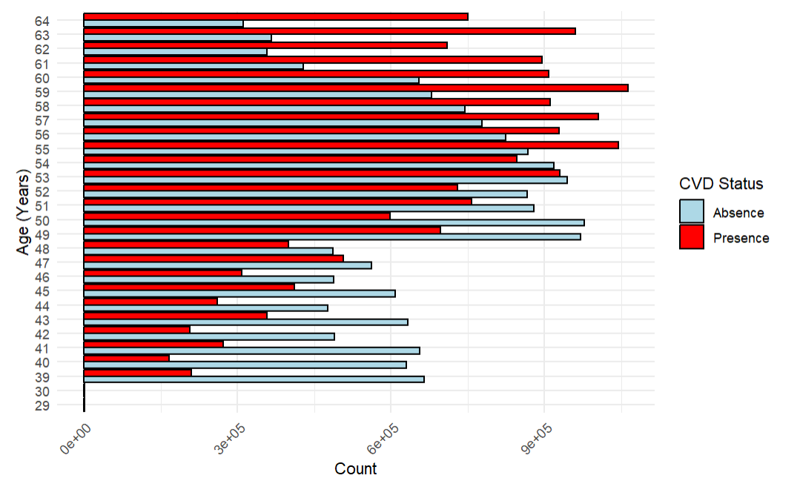
It is evident that the prevalence of CVD increases with age. The red bars (indicating the presence of CVD) are relatively small for younger age groups but become progressively taller as the age increases, peaking around the late 50s and early 60s.
The light blue bars (indicating the absence of CVD) are taller for younger age groups and gradually decrease in height as the age increases, indicating a lower proportion of individuals without CVD in older age groups.
The risk or incidence of CVD is lower in younger individuals and increases significantly with advancing age, potentially due to various factors such as lifestyle, genetics,

Slide 18
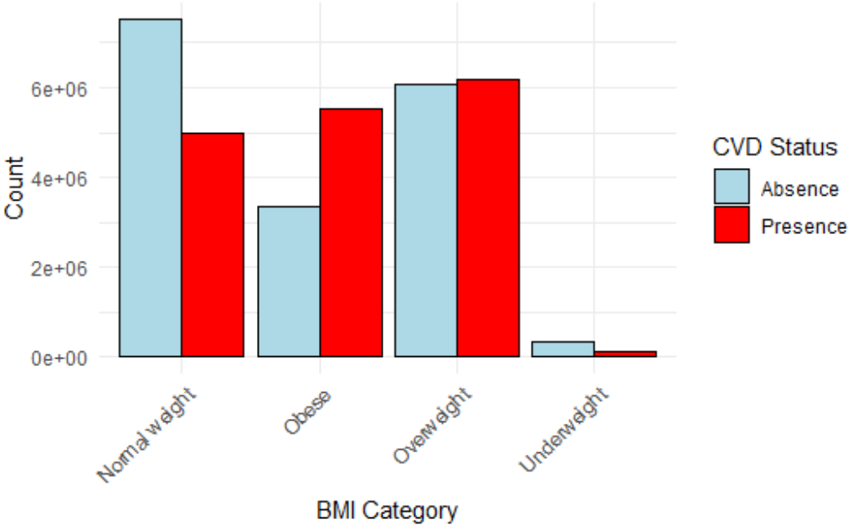
For the Normal Weight category, the blue bar (absence of CVD) is taller than the red bar (presence of CVD), indicating a higher prevalence of individuals without CVD in this category.In the Obese and Overweight categories, the red bars (presence of CVD) are taller than the blue bars (absence of CVD), suggesting a higher prevalence of CVD among individuals who are obese or overweight.
The Underweight category has a very low count overall, with a slightly taller blue bar (absence of CVD) compared to the red bar (presence of CVD).The tallest red bar is observed in the Obese category, indicating a potentially higher risk of CVD for individuals with obese compared to other BMI categories.

Slide 19
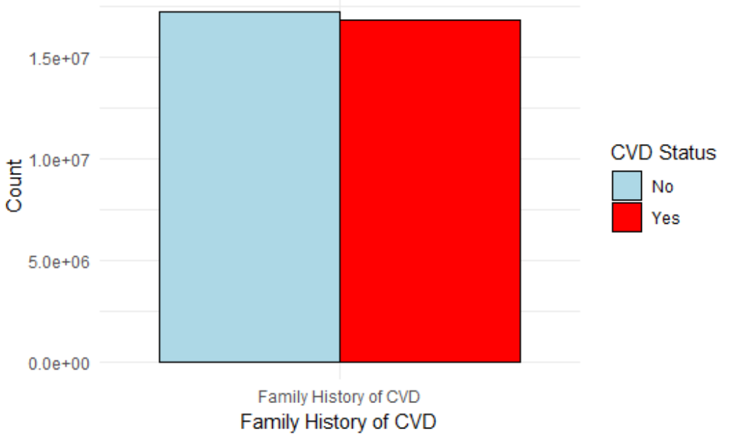
The blue bar, which corresponds to individuals with CVD, is slightly taller than the red bar, indicating a slightly lower count or prevalence of CVD among those with a family history of the disease.
The blue bar, representing individuals without CVD, is larger than the red bar, suggesting a lower count or prevalence of individuals without CVD among those with a family history of CVD.
Individuals with a family history of CVD have a slightly lower likelihood or prevalence of developing CVD themselves, compared to those without a family history of the disease

Slide 20
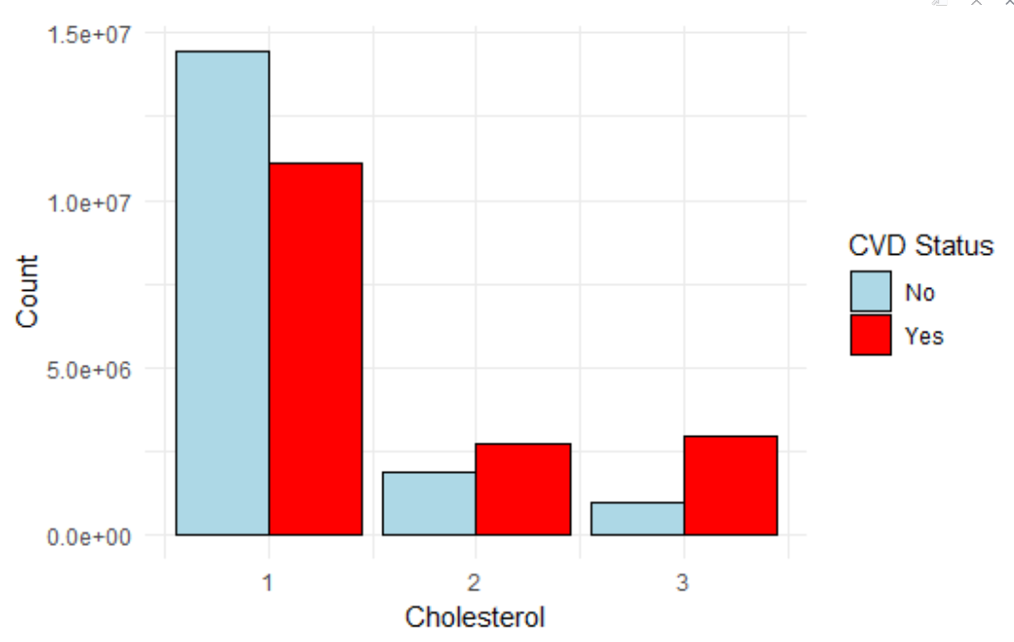
At cholesterol level 1, there is a significantly higher count of individuals without CVD (blue bar) compared to those with CVD (red bar).
For cholesterol levels 2 and 3, the counts of individuals with CVD (red bars) are higher than those without CVD (blue bars).
The highest count overall is observed for individuals without CVD at cholesterol level 1, indicating a larger population with lower cholesterol levels and no CVD.
The counts for individuals with CVD appear to be higher at cholesterol levels 2 and 3, suggesting a potential correlation between higher cholesterol levels and the presence of CVD.

Slide 21
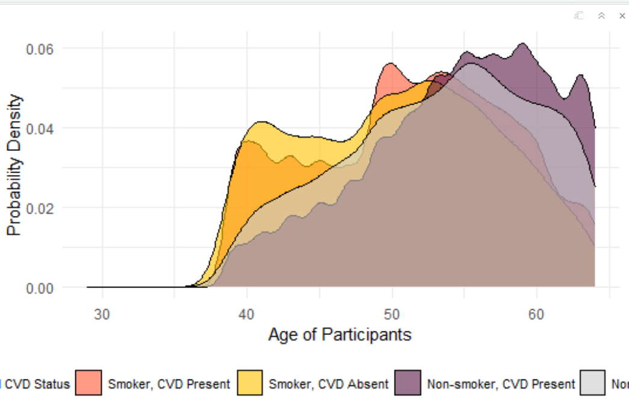
The graph shows the probability density distribution across different age groups (30-60 years) for participants categorized by their smoking status and presence or absence of cardiovascular disease (CVD).
Smokers without CVD (yellow curve) have the highest probability density in younger age groups (around 30-40 years).Smokers with CVD (orange curve) have a lower probability density across all age groups compared to smokers without CVD. Non-smokers with CVD (purple curve) exhibit a higher probability density in older age groups (around 50-60 years).

Slide 22
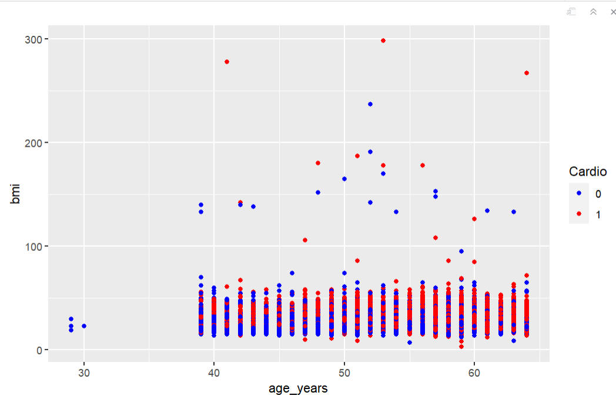
The x-axis represents age in years, ranging from around 30 to 60. The y-axis shows BMI, with values ranging from 0 to approximately 300.
The red data points (1) tend to have higher values on the y-axis, indicating a potential association between this group and poorer cardiovascular health outcomes or higher risk.
This scatter plot highlights the relationship between age, a binary variable (possibly presence/absence of a condition or risk factor), and bmi.

Slide 23
Data Management: Data Cleaning and Preprocessing: We started by inspecting the dataset for any obvious errors, inconsistencies, or duplicates. This involved checking for invalid or out-of-range values, missing data, and any formatting issues. We removed any duplicate rows or observations, as they can introduce bias and skew the results and we deleted unwanted columns which are unnecessary for our research. Data Transformation: BMI was changed from number to integer for better results. Variable Selection: We have removed repeated columns and the columns which are unnecessary for our research. Data Aggregation: We have combined 2 datasets from kaggle. Data Integration: We integrated 2 datasets ensuring consistency in variable names, formats, and units.

Slide 24
Output of Logistic Regression: Based on the output:- All coefficients are statistically significant with p-values less than 0.05, suggesting that age_years, bp_category, smoke, and alco are all significantly associated with the presence of cardiovascular disease (cardio).- The estimated log odds of cardiovascular disease increase with increasing age (age_years), higher blood pressure categories (Hypertension Stage 1 and Hypertension Stage 2), smoking (smoke), and alcohol consumption (alco).- The Null deviance and Residual deviance provide information about the goodness of fit of the model. A lower residual deviance indicates a better fit of the model to the data.- The AIC (Akaike Information Criterion) is a measure of the relative quality of the model, with lower values indicating better fit.- The number of Fisher Scoring iterations provides information about the convergence of the optimization algorithm used to fit the model.

Slide 25
Hypothesis Testing: Performed chi-square tests and ANOVA tests to examine the associations between categorical variables (smoking, alcohol consumption, BMI, glucose levels, cholesterol levels, blood pressure categories) and cardiovascular disease.

Slide 26
CONCLUSION

Slide 27
1. Significant Risk Factors: Smoking status, alcohol consumption, BMI category, and glucose levels are all found to be significantly associated with cardiovascular disease. This suggests that individuals who smoke, consume alcohol, have higher BMI categories, or exhibit abnormal glucose levels may have an increased risk of developing cardiovascular diseases. 2. Non-Significant Factors: The analysis did not provide a conclusive result regarding the association between gender and cardiovascular disease. Further investigation may be warranted to explore this relationship in more detail. 3. Importance of Modifiable Risk Factors: The significant associations observed with modifiable risk factors such as smoking, alcohol consumption, BMI, and glucose levels highlight the importance of lifestyle modifications and interventions in reducing the risk of cardiovascular diseases. Targeted interventions aimed at reducing smoking rates, promoting healthy alcohol consumption, maintaining optimal BMI levels, and managing glucose levels could potentially contribute to lowering the prevalence of cardiovascular diseases. 4. Need for Further Research: While the analysis provides valuable insights, there may be other factors not included in the dataset that could also influence cardiovascular disease prevalence. Additionally, longitudinal studies or randomized controlled trials could provide more robust evidence of causality and further elucidate the complex interactions between various risk factors and cardiovascular disease outcomes.

Slide 28
Reference: 1) A Systematic Review of Major Cardiovascular Risk Factors: A Growing Global Health Concern https://www.ncbi.nlm.nih.gov/pmc/articles/PMC9644238/ 2. Modifiable risk factors in adults with and without prior cardiovascular disease: findings from the Indonesian National Basic Health Research https://bmcpublichealth.biomedcentral.com/articles/10.1186/s12889-022-13104-0 3. Association of Habitual Alcohol Intake With Risk of Cardiovascular Disease https://jamanetwork.com/journals/jamanetworkopen/fullarticle/2790520 4. Global Effect of Modifiable Risk Factors on Cardiovascular Disease and Mortality https://www.nejm.org/doi/full/10.1056/NEJMoa2206916

Slide 29
THANK YOU

